Slide 1
Notes to the Presenter
Slides 2-10 contain notes for the presenter and are hidden.
You may include your picture and company logo on the intro slide only
It is appropriate to provide a brief background (1 minute or less) on your organization.

Slide 2
Presentation Best Practices
Frame your presentation by answering:
What do you want your audience to learn?
What do you want your audience to do differently?
What result or outcomes do you want your audience to realize?
Clarify your session objectives at the beginning of your presentation.

Slide 3
Presentation Best Practices
Pictures speak 1,000 words; include a screenshot or picture on each slide to add visual interest.
A good goal is to aim for 7 words per slide.
Increase attention and interaction by using a variety of communication mediums, such as polls and videos.
Plan and follow a rough agenda including a breakdown by minute to help stay on track.

Slide 4
Example of Text Layout
Main topic 1: size 28pt
Size 24pt for the subtopics
Size 24pt for the subtopics
Main topic 2: size 28pt
Size 24pt for the subtopics
Size 24pt for the subtopics
Main topic 3: size 28pt
Size 24pt for the subtopics
Size 24pt for the subtopics

Slide 5
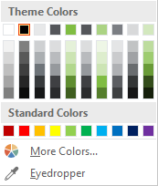
Slide Palette Info
The PowerPoint palette for this template has been built for you and is shown below. Avoid using too many colors in your presentation.
Select the 4th color from the left for subheads and 1st level non-bulleted text color, or wherever “color” text is preferred over the default black/white text
Accent colors 1-6 – (6 Theme Colors to the far right)
Text
Dark 2
Accent 1
Accent 2
Accent 3
Accent 4
Accent 5
Accent 6
Use Accent 1 as the main accent color. Use Accent 2 and Accent 3 when additional colors are needed.
Use Accents 4-6 sparingly – only when more colors are necessary.

Slide 6
Chart Example

Slide 7
Lots of data? Minimalize and Plan
Gray is used to de-emphasize data that is less important. Use cool gray 3 or cool gray 7. See slide 7 for color formulas.
All elements have the same interior margins as text blocks.
When a chart or graphic, has more elements than can easily be aligned to the grid, align the outer edges of the group, top, bottom, left and right edges to the grid.
It is preferable to keep the group aligned to the left border.
130M
140M
125M
Other
Other
Other
Other
Other
Other

Slide 8
Chart Example

Slide 9
Notes (hidden)
Some speakers like to use this slide for hidden “notes slides”.
Delete it if you don’t want to use it.

Slide 10



GLOBAL POWER PLATFORM BOOTCAMP
Organized Globally, Held Locally

Slide 11
Working with Power Apps Portals
Mahender Pal

Slide 12
Working with Power Apps Portals
Mahender Pal

Slide 13




About Me
Principal Consultant in HIMBAP
12+ years of experience Dynamics CRM
Former 7 times Microsoft Dynamics CRM MVP (Reconnect MVP Member)
4 times Csharpcorner MVP
Authored 2 Microsoft Dynamics CRM Books
himbapinfo
himbap.com/blog
mpal@himbap.com

Slide 14
Getting Started with Power Apps Portals
Understand Power Apps Portal
Know about Portals Licensing
Setup Portals App
Customize Portals
Demo

Slide 15
Session Agenda
Introduction to PowerApps Portals
Quick overview of Portals License
Setting up Power Portals
Customizing Portals
Demo

Slide 16
Introduction to PowerApps Portals

Slide 17
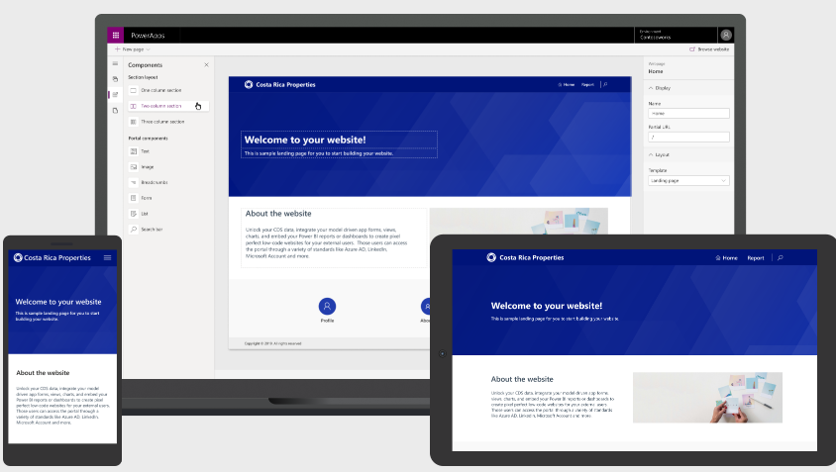
What is Portals
Responsive Power Full Website
Provides low code no code designer for our website
Different Authentication Options
Integration with CDS database
Ability add PowerApps
Notes:
Using new designer we can simply drag and drop controls like we can do with powerapps
User can be internal or external, it can be our customer or partners
We can setup Webroles to allow them to our portal website as anonymous user
The user of the app will need to be at least a guest user in your Azure Active Directory to access power apps in portal
Need to follow particular syntax to place canvas app into portals

Slide 18
Portals License
Users Type
License Model
Internal Users - Employees
Power Apps Or Dynamics 365
External Authenticated User
Per Login
External Un-Authenticated User
Page View

Slide 19
Portals License
External User
Authenticated User
Anonymous User
Capacity 100 Logins /month For 200 $
Capacity 100000 Page View/month
Capacity 1000 Logins/month For 1000 $
For 100 $
Capacity 5000 Logins/month For 3500 $ only CSP

Slide 20
Portals License
Power Apps User (Internal)
Per App Plan
Per User
Single Portal App
Unlimited Portal App
For 10 $/user/month
For 40 $/user/month

Slide 21
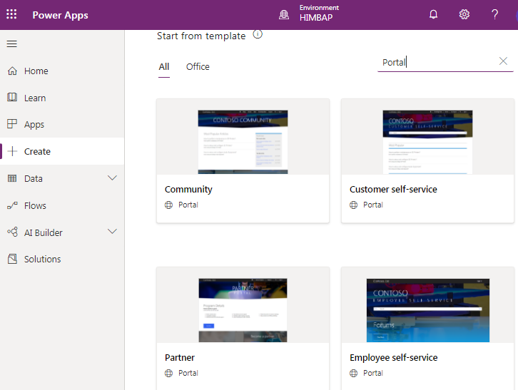
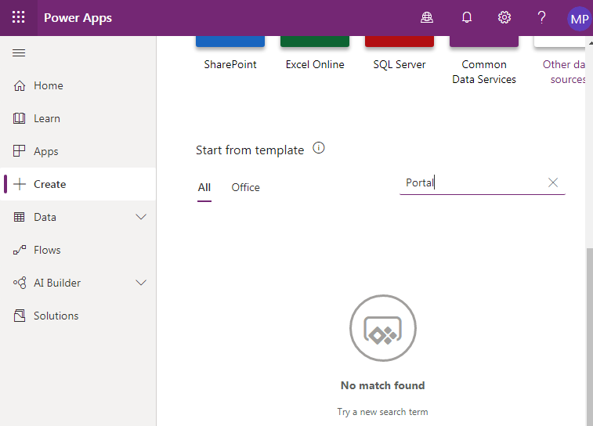
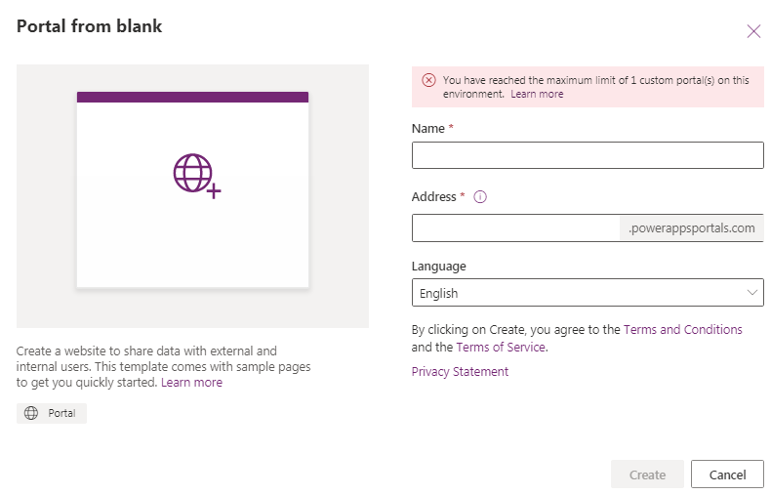
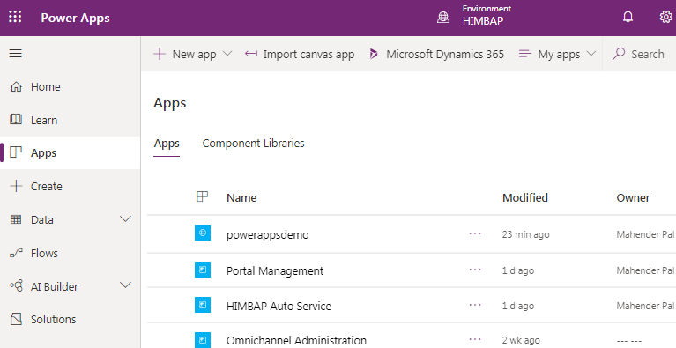
Setup Portals App
We can use template or can create as blank Portal
Template will be different based on the Environment
Portal Management App is created

Slide 22
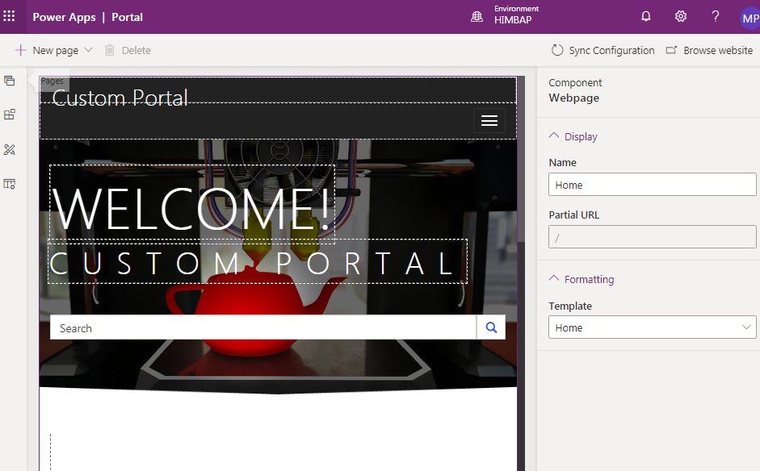
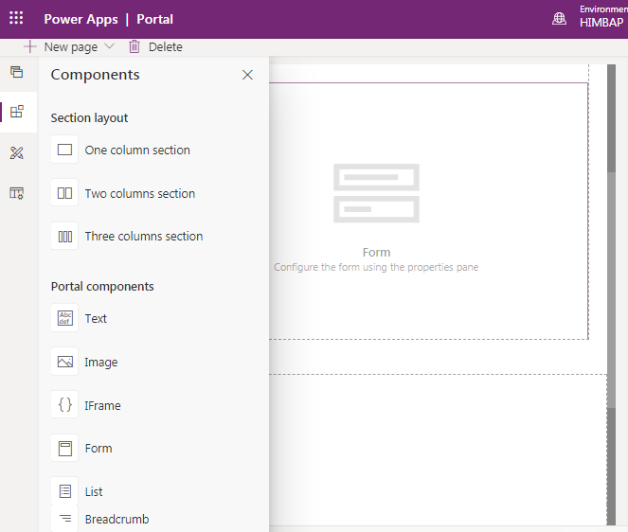
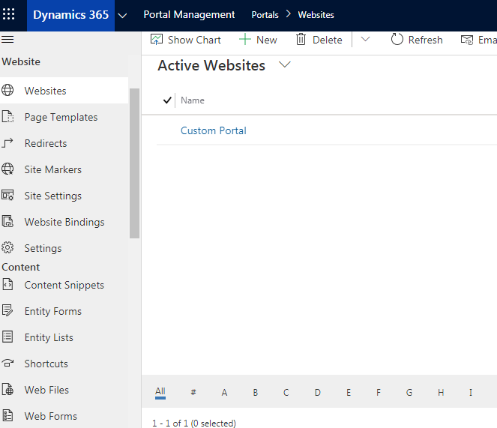
Customizing Portal
We can configure our portal setting using Management App
We can use Portal App Editor to customize our Portal
We can new page and place different component

Slide 23
Demo

Slide 24
Any Questions?

Slide 25
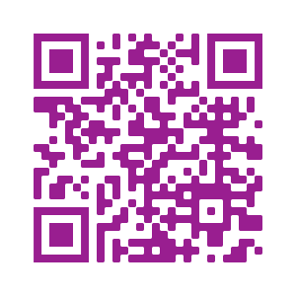
Please fill out the survey! & Win Swags!!
https://www.powerplatformbootcamp.com/survey

Slide 26
Thank You For Attending

